Slide 1
Structuring First-Year Retention at a Regional Public Institution: Validating and Refining the Structure of Bowman’s SEM Analysis
Daniel A. Collier – W.E. Upjohn Institute for Employment Research
Dan Fitzpatrick – University of Michigan
A Presentation for the SFRAN National Conference – June 12th, 2020

Slide 2

Please Feel Free to Share!
Share anything you’d like on Social Media about this Research – We also have a working paper up on SSRN.

Slide 3
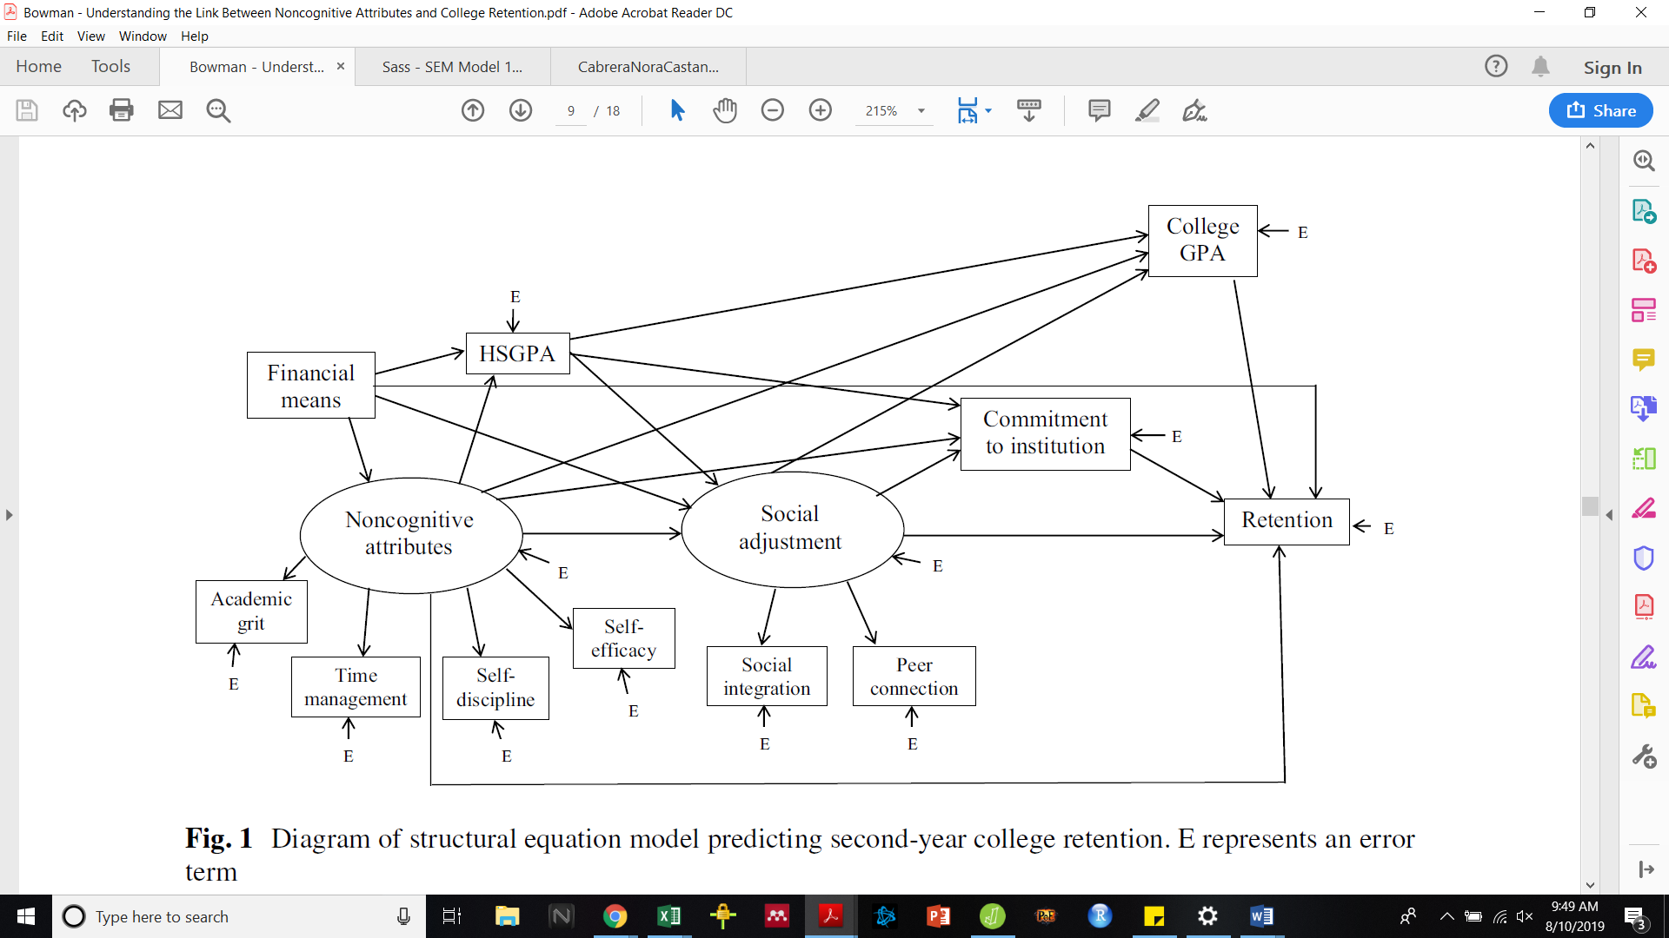
Bowman et al. (2019) Model
Used Structural Equation Modeling to test how student non-cognitive attributes affect first-year stop out
Model developed with 10,000 students across multiple institutions
Few SEM analyses are in HE journals or attached to HE-related theory
The Bowman model illustrates that the outcome of retention is directly influenced by the combination of College GPA (r=.50), Commitment to Institution (r=.21), Social Adjustment (r=.16), Financial Means (r=.09), and Non-Cognitive Attributes (r=-.15) – with indirect influences positively bolstering each of the variables. Of particular interest, indirect influences bring the non-cognitive attributes (r=.14) to a net-positive total influence on retention - aligning with the study’s central assumption.

Slide 4
Our Study
Used SEM to test the structure of the Bowman et al. (2019) with unique data that research suggests is similar in nature to variables in the “Bowman Model.”
We also expanded upon the Bowman Model by including Food Security to the financially-related latent variable
  To date, three SEM studies with food insecurity in publication
  One in a HE journal, two in other journals – all three are very limited and do not examine effects on performance/persistence.

Slide 5
Site and Sample
Conducted at Western Michigan University under the Success at WMU program and funded by a First In The World Grant (P116F140353) provided by the Department of Education
First-Time In Any College (“Beginner” students) N=2,351 students invited to participate, N=487 engaged (21%)
Participants were
  Less advantaged ($71,000 v. $76,000)
  Higher HS FRL% (31% v. 29%)
  Higher HS GPA (3.56 v. 3.40)
  More Non-White Persons (33% v. 27%)
  More Female (63% v. 48%)
  Higher First-Year GPA (3.20 v. 3.00)
  Higher First-Year Retention (80% v. 74%)

Slide 6
Structural Equation Modeling
  Structural Equation Modeling (SEM) is a technique used to examine the effect of one variable onto another and any indirect influences from one variable through another (Klem, 2000)
  Rules of SEM
    Temporal sequencing
    Variables must be statistically related to the outcome examined
    Method must align with outcome
      Weighted-least square means and variance adjusted approach (WLSMV)
      WLSMV is a better approach than a Maximum Likelihood analysis; WLSMV produces more accurate factor loadings, interfactor correlations, and structural coefficient estimates (DiStefano & Morgan, 2014; Li, 2016).
    Fit statistics are debated but should be CFI≥.95, TLI≥.95, RMSEA≤.06, and SRMR≤.08 (Hu & Bentler, 1998)
Had n=11 profiles with missing institutional, we listwise deleted them. Was not large enough to mean center or KNN the data.
Notes:
Standardized Coefficients are reported. Standardized coefficients report relative “size” of influence on the mean of the examined variable, allowing for comparisons by converting all variables to a mean of 0 and measuring the impact of a standard deviation (Kwan & Chan, 2011).

Slide 7
Data Sources and Survey
Again this is not the same data as used by Bowman et al. (2019) but our data captures similar elements – which we soon detail.

Slide 8
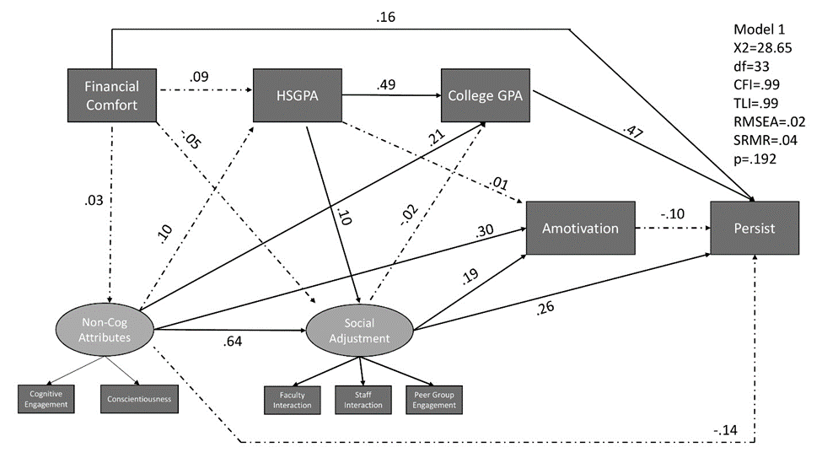
Model 1 – Replication of Bowman Structure
Notes:
Fin Comfort = Fin Stress Scale
Non-Cog = Bowman looked at Grit, Time Management, Self-Discipline, and Self-Efficacy. Conscientiousness is arguably a better measurement of students’ focus and intention than Grit is (Crede, et al.) and Cognitive Engagement is a combined measurement of self-efficacy, focus, and management of time to achieve academic goals.
Social Adjustment – specifically included staff interactions
Amotivation – replacement for Intent to Persist. Amotivation asks “I don’t know what I am doing here” questions and gauges how students feel about the control the that have while perusing this goal.
Everything is positive – we reverse coded Fin Stress, Food Insecurity, and Amotivation.

Slide 9
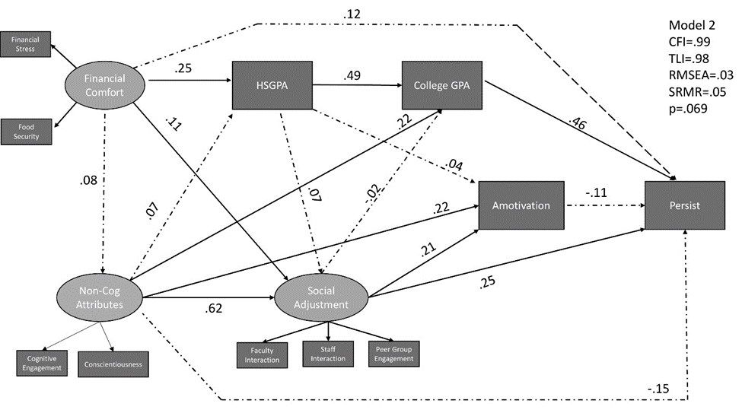
Model 2 – Expansion of Bowman Structure
Notes:
Here, we added Food Security the Financial Comfort to make it a latent variable. Yes, we ran a CFA.

Slide 10
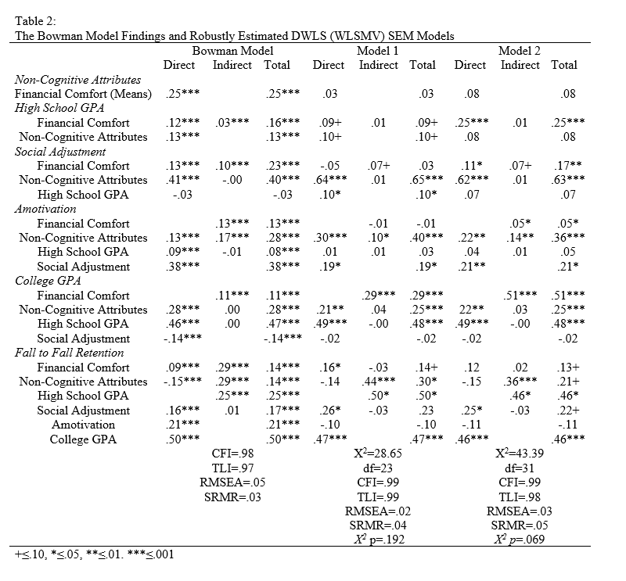
Let’s Compare
Model Outcomes
Notes:
First let’s look at model fit our models are stronger than the Bowman Model. Model 1 is a slightly stronger better fit than Model 2 – however, both models fall within the “Optimal Fit” range. This suggest the structure of the Bowman model was a good and fits for unique students with unique data plugged in.

Slide 11
Let’s Compare
Model Outcomes
Notes:
Although our model fits are stronger, we do not see all of the same relationships. For example we do not see Financial Comfort influence non-cog attributes (this runs counter to our own descriptive research). The lack of these various relationships are important to understand, think through, and test. Likely we do not always find statistical relationships where Bowman did because our data (survey constructs) are different even if we make connections to similar themes. Second, our sample is more focused on a regional public institution – which actually serves a rather affluent student population.

Slide 12
Let’s Compare
Model Outcomes
Notes:
The significant relationships are also important to highlight - prior performance consistently predicts future performance, which is exactly what we would expect.
Non-Cog attributes are important factors in social adjustment, Amotivation, and College GPA. Also remain indirectly impactful and depending on the model – significant for persistence.

Slide 13
Let’s Compare
Model Outcomes

Slide 14
Amotivation
Was not a good substitute for Intent to Persist in the way we have collected it.
  If you plan to replicate please use Bowman et al. (2019) items or other SEM items that have already proved the concept.
  Maybe change in Amotivation from early first-semester to end of first-year would be valuable?
Given that Amotivation has linkages to student outcomes we examined if it could be nested within student non-cognitive attributes and the EFC did not accept this. We also reconfigured connections and Amotivation was not a valuable addition to the model as significant linkages to first-year college performance and student attributes were not found.

Slide 15
So what?
Well the structure of the Bowman et al. (2019) model is rather robust and remains suitable for plugging in data that theoretically measures similar constructs.
True testing is required still; however, this is hard to do as SEM requires large sample sizes and not everyone collects the same data – but we should try to replicate either the Bowman Model or the models generated by my team.
  You will need about n=400 (at min) to test these models
The inclusion of Food Security produced a slightly weaker model (but still an optimal model) and has produced several relationships we would have expected to see not found in Model 1.
  While statically slightly weaker, in connection with the Bowman Model and prior research Model 2 may be a “better” practical model.
Food security matters… My team has highlighted this in descriptive analyses as have others. Our model shows this and we hope others are able to incorporate this measurement into future SEM and other causal analyses.

